Slide 1
Using Machine Learning to achieve energy aware Kubernetes scaling
Thomas Leath

Slide 2
Problem Statement
Kubernetes is a framework designed to automate deploying and hosting application through containers. They are used as they allow large applications to be run anywhere whilst maintaining availability and scale easily without oversight. The way they deal with load is through autoscalers.
Traditional Kubernetes auto-scalers automatically scale the size of pods, containers or nodes in a cluster based on the demands of the current workload. This means the demand for extra resources is already present before more can be provisioned and, by definition, makes them reactionary leading to inefficient resource utilisation and thus wastes energy

Slide 3
Aim & Objectives
This project aims to create a Machine Learning model that can be used by the auto-scaler to proactively scale resources in anticipation of demand. This will help avoid over provisioning whilst maintaining the required performance and availability, reducing the consumption of the system.
Build and train a machine learning model to predict future demand based on current workload
Build and train a model to provide the optimum node count based on workload and concurrent users
Create a framework to integrate machine learning models to inform a Kubernetes Horizontal Pod Autoscaler

Slide 4
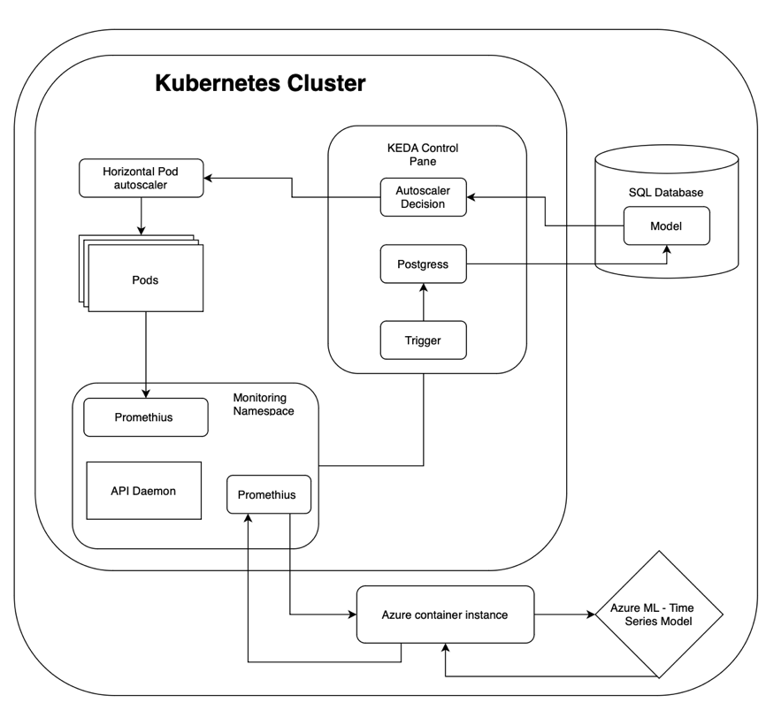
Design
A metric gathering software (Prometheus) listens to the Kubernetes load.
This load data is periodically communicated to an Azure Container
This data is then formatted and inputted into a Machine Learning Model which produces a prediction for load at a predefined number of minutes in the future
This is returned to the instance and then to the API Daemon
This prediction of workload is then communicated with the the Kubernetes Control pane triggering it to feed the prediction to the second model. Which in turn returns the optimum number of pods for the node to use
The Node is then scaled appropriately

Slide 5
Implementation
Data - I am using the WorldCup98 data set. This dataset tracks the Requests per minute for the WorldCup98 website over 3 months. This provides more than enough information to train a model and can provide a fair representation of traffic fluctuation over a period of time.
Models – The system will use two models. One is a time-series model with the sole responsibility of predicting future load based off previous data. The second model will determine the optimum pods to be running for this load. This is done by iteratively testing the cluster with different number of pods at different load. The optimum will be the number of pods that consumes the least energy whilst maintaining a minimum level of lost requests.
This combination allows the framework to be web app specific. By understanding the specific resource needs of an application at different load levels, the system can make more informed scaling decisions. This leads to better resource utilization and minimizes the risk of SLA violations or over-provisioning.
This also means the Solution is modular and thus can be used as a framework to be applied to any web app.

Slide 6
System Evaluation Plan
The benchmark for this project will be the Kubernetes standard, reactive Horizontal Autoscaler.
Both the standard auto-scaler and my pro-active system will be load tested using the WorldCup98 data set using a software called k6. The performance of both will be measured using 3 metrics:
Energy consumed – The amount of energy consumed by the cluster over the test period
Lost requests – the number of requests that couldn’t be fulfilled by the cluster. This will represent how well the SLA is being met (under-provisioning)
Cost – The cost will determine if the autoscaler is over-provisioning (over allocating resources)

Slide 7
Remaining Work
Week 6 (This week)
Get Chapter 1 reviewed
Create first instance of time series model
Create first instance of workload profiling model
Integrate the models into the auto-scaler and have it inform the autoscaler
Week 7
Develop ML model
Create an accurate workload profile for the web app
Start chapter 2
Week 8
Evaluate and finalise both models
Run tests on the system as a whole against benchmark to gather performance data
Over Easter
Complete Chapter 2
Complete Chapter 3
Start and Complete Chapter 4
Week 9-10
Add the finishing touches to the report.
Submit the report and all supporting documents and repositories.

Slide 8
Write Up
Current Progress:
Drafted Chapter 1
Early Discussion points
The efficiency of the system will be influenced by choosing how regular the pods should be rescaled and this (the how far in the future the model should look)
The system being built can be make bespoke to every web app. Whilst meaning it isn’t a general solution it will be highly effective. It’s modular design also means very little needs to be changed for each user. Only the two models need to be retrained for that web apps usage profile and web traffic.

Slide 9
Software Demo

